Slide 1
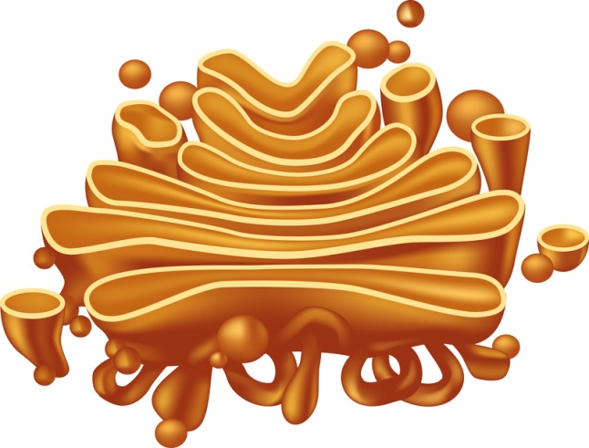
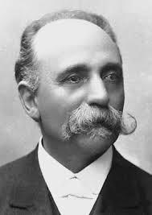




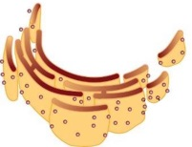

Golgi apparatus
(Golgi complex) :
It was first described by a German scientist “Camillo Golgi”.
These sacs are called cisternae and are filled with different enzymes.
It comprises of membrane- bound vesicles approximately parallel to each other.
It is considered as the packing and forwarding department of the chemical factory of the cell.

Slide 2

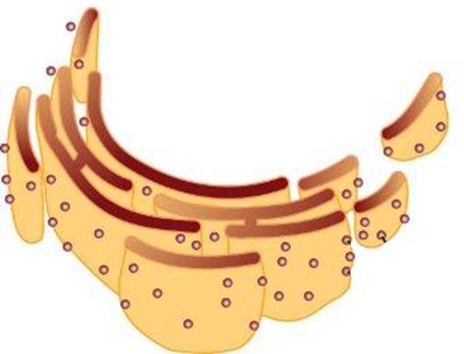
Functions of golgi apparatus :
The material synthesised near the endoplasmic reticulum is packaged and dispatched to various targets inside and outside the cell through the Golgi apparatus.
Its function include the storage, modification and packaging of products in vesicles.

Slide 3
Functions of golgi apparatus :
The material synthesised near the endoplasmic reticulum is packaged and dispatched to various targets inside and outside the cell through the Golgi apparatus.
Its function include the storage, modification and packaging of products in vesicles.
In some cases, it also converts simple sugars into complex sugar.
The golgi apparatus is also involved in the formation of lysosomes.

